Slide 1
Web Application
“one to infinity”
ABOUT
Features
CONTRIBUTION
TIMELINE
DEMO PRESENTATION
Group 36: Caroline Xu, Yuqi Bai, Jianglong Xing, Xuelin Liu
DEMO PRESENTATION

Slide 2

Introduction
ABOUT
Features
CONTRIBUTION
TIMELINE
01
PROJECT PROPOSAL

Slide 3
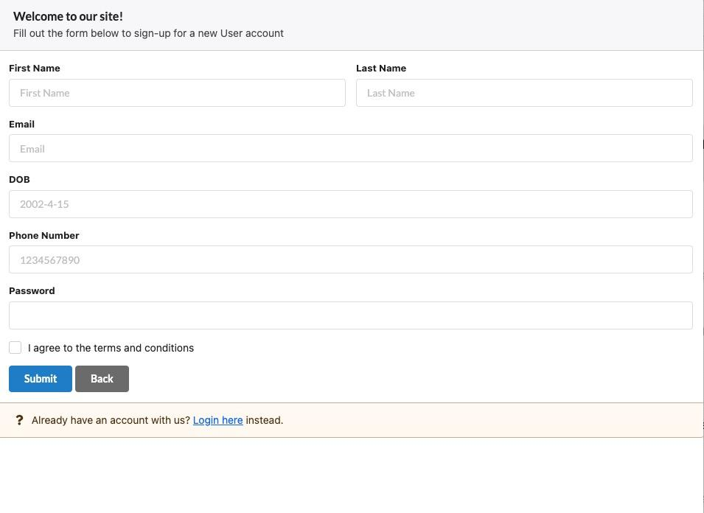
User Signup

Slide 4
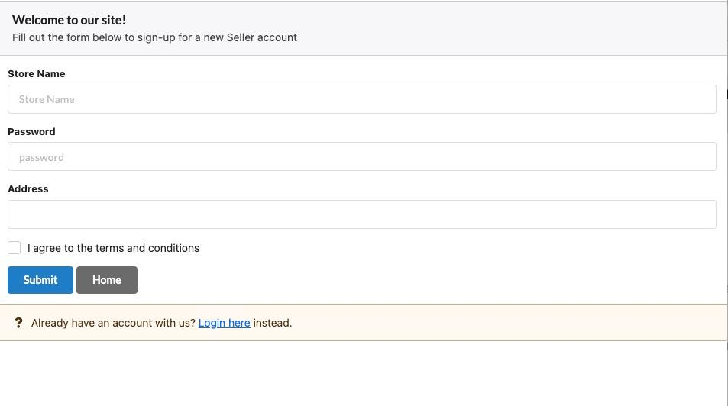
Seller Signup

Slide 5
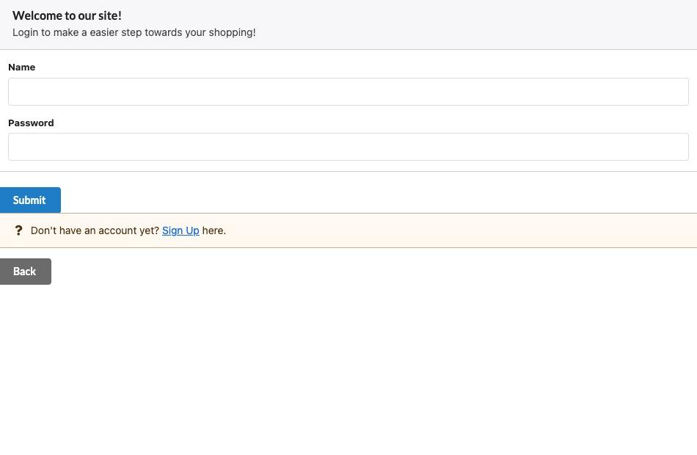
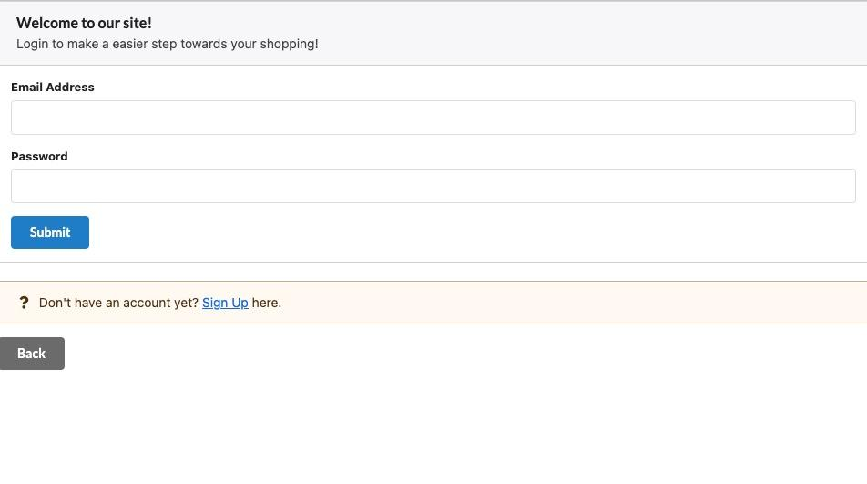
Login

Slide 6
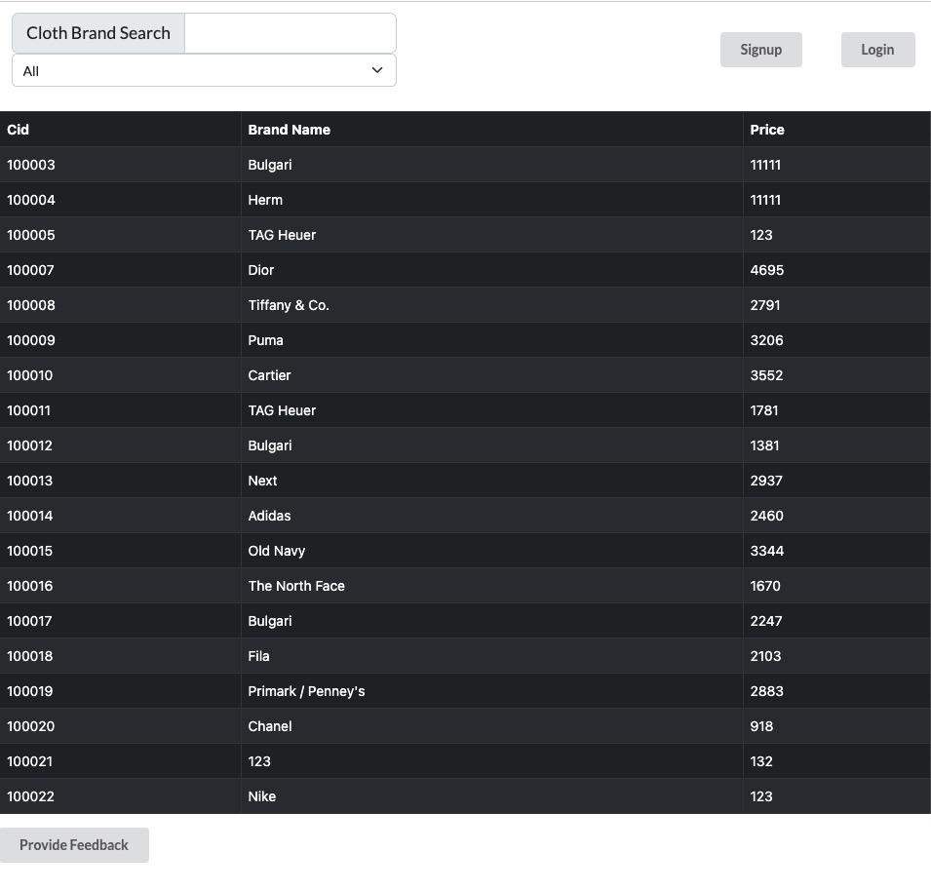

Slide 7
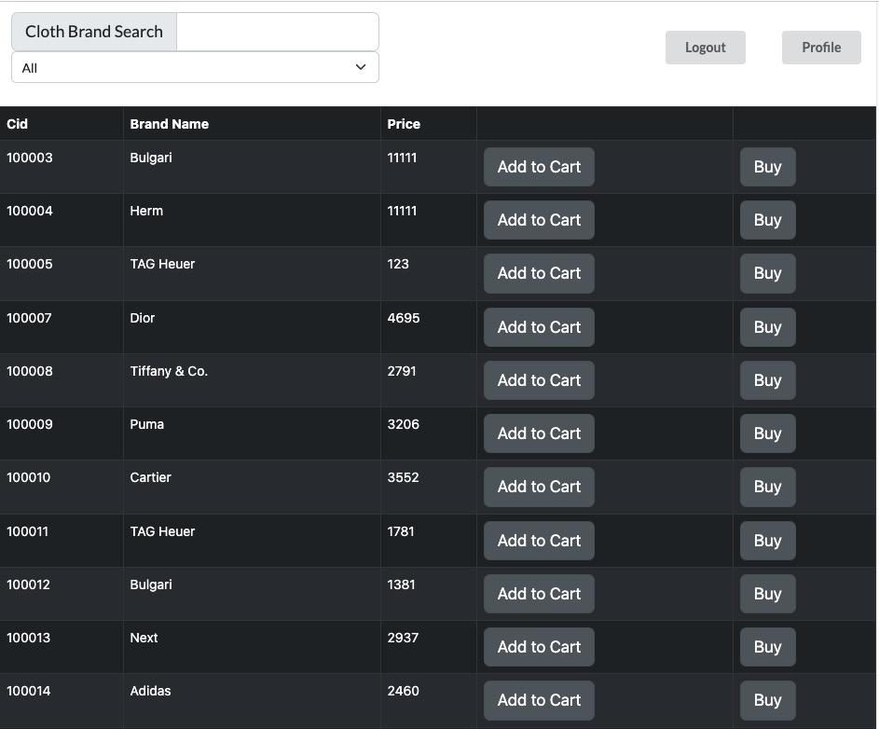

Slide 8
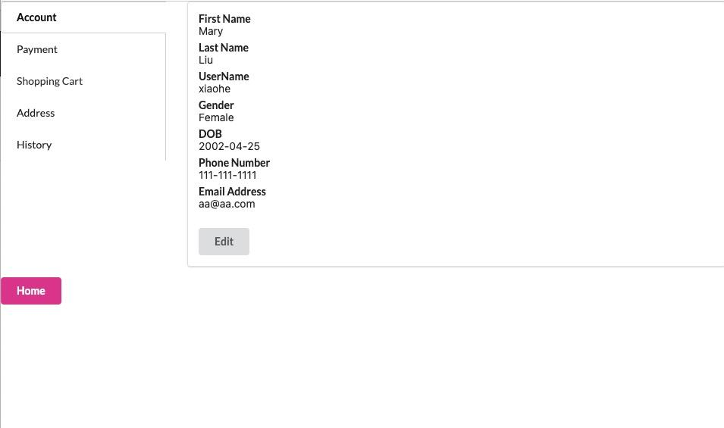

Slide 9
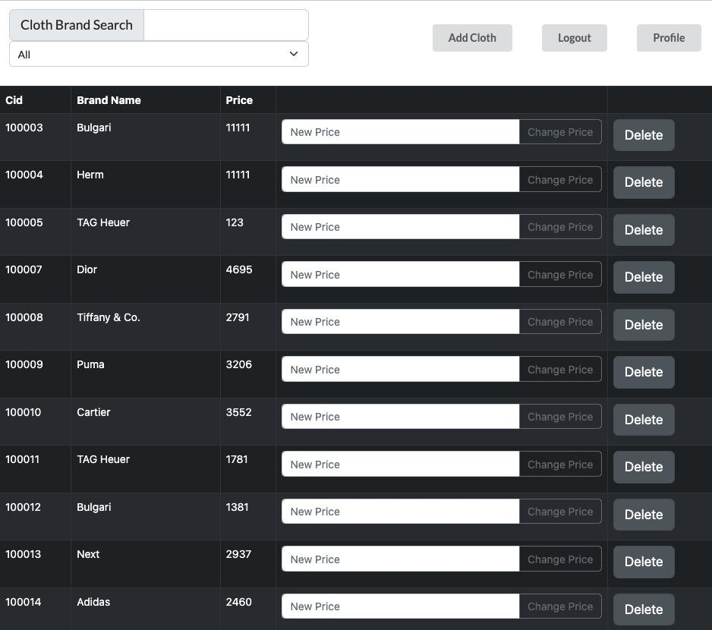

Slide 10

Features
ABOUT
Features
CONTRIBUTION
TIMELINE
02
PROJECT PROPOSAL

Slide 11
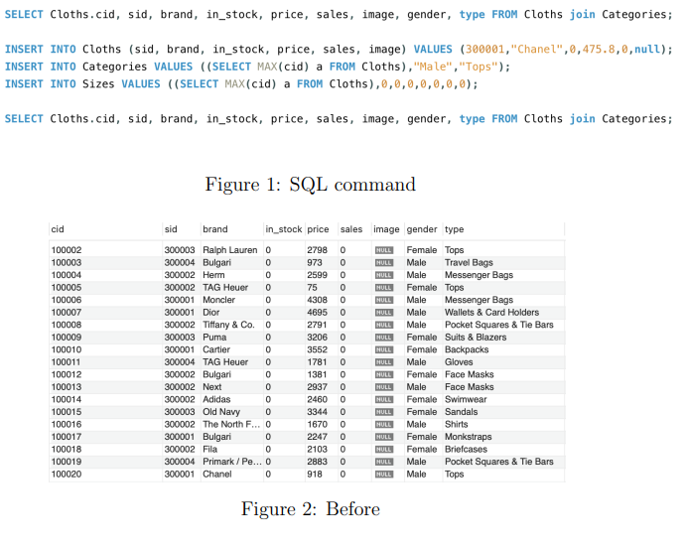
Feature 1 - to upload
ABOUT
Features
CONTRIBUTION
TIMELINE
DEMO PRESENTATION

Slide 12
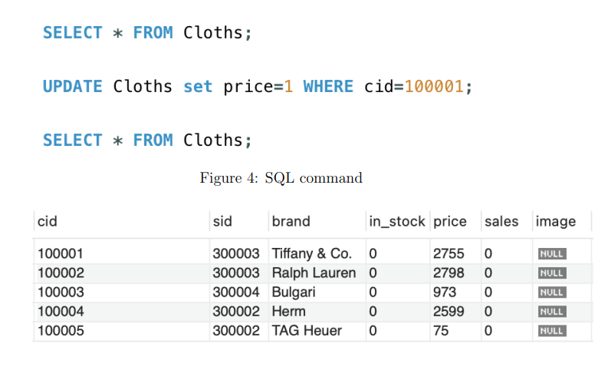
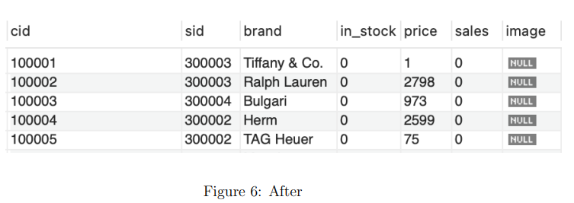
Feature 2 - to modify
ABOUT
Features
CONTRIBUTION
TIMELINE
DEMO PRESENTATION

Slide 13
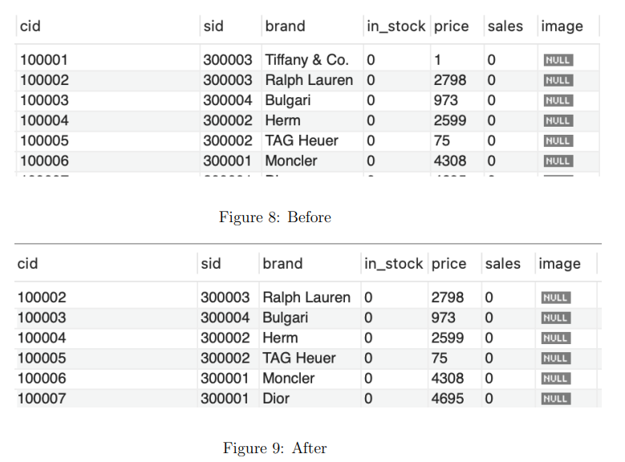
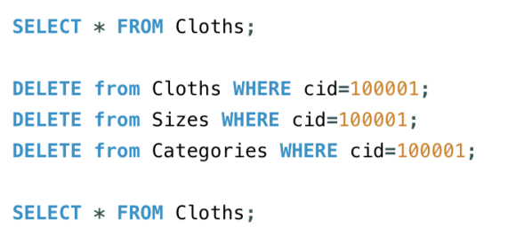
Feature 3 - to delete
ABOUT
Features
CONTRIBUTION
TIMELINE
DEMO PRESENTATION

Slide 14
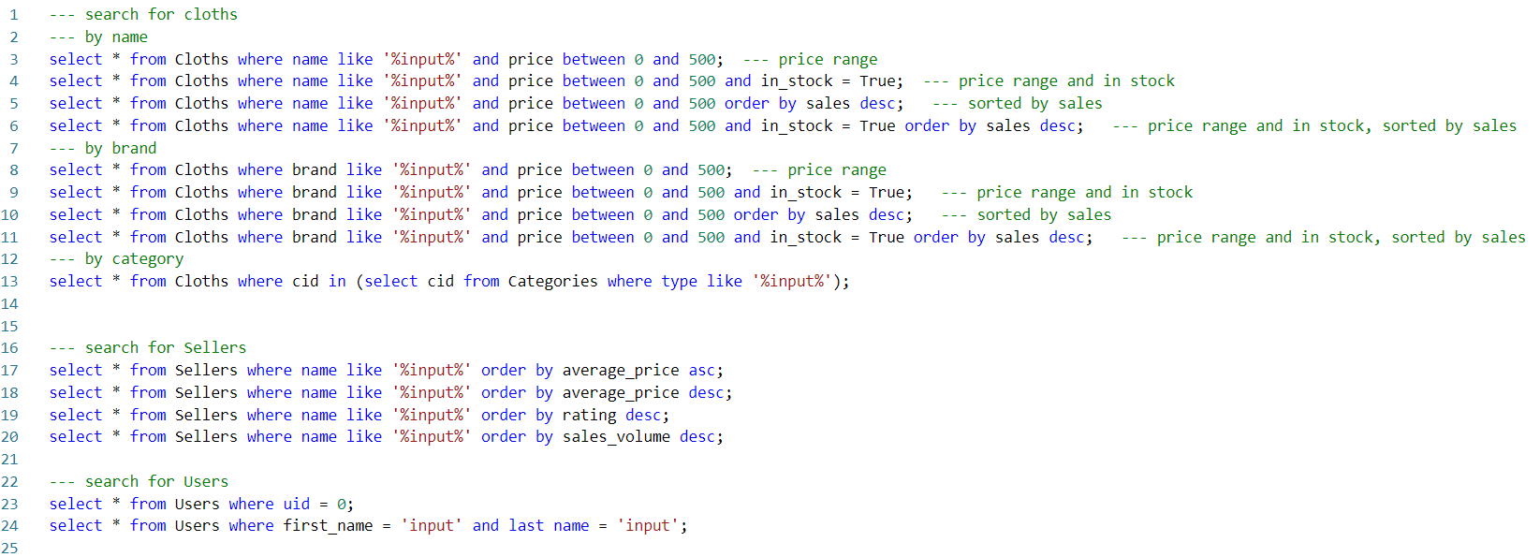
Feature 4 - to search
ABOUT
Features
CONTRIBUTION
TIMELINE
DEMO PRESENTATION

Slide 15
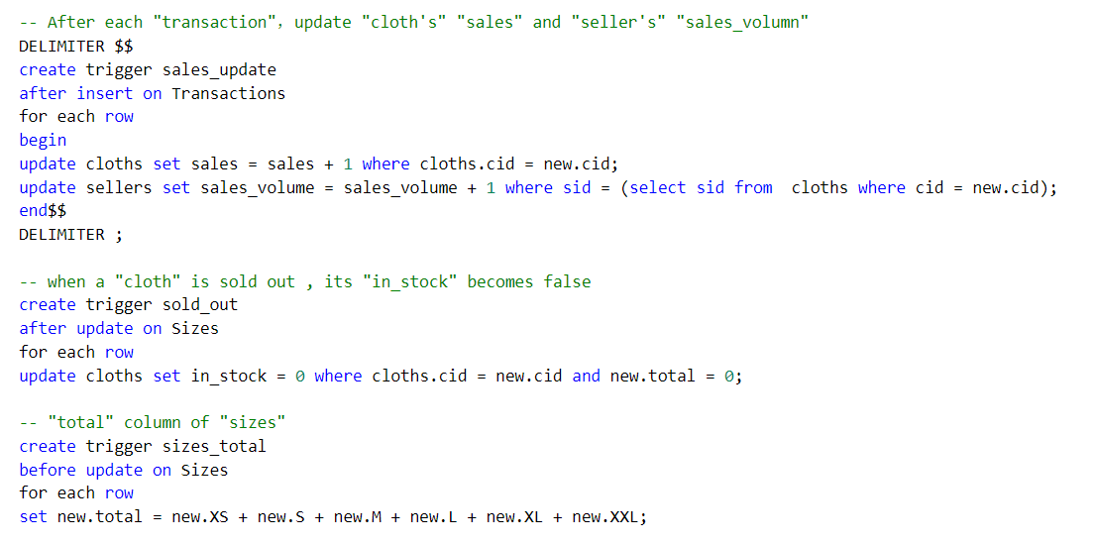
Feature 5 - to update information on time (using triggers)
ABOUT
Features
CONTRIBUTION
TIMELINE
DEMO PRESENTATION

Slide 16
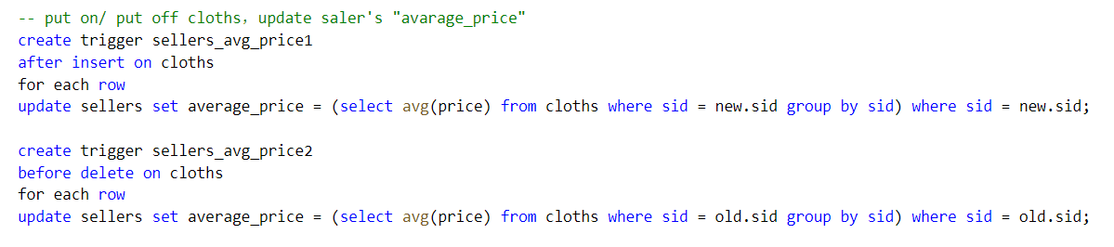
Feature 5 - to update information on time (using triggers)
ABOUT
Features
CONTRIBUTION
TIMELINE
DEMO PRESENTATION

Slide 17
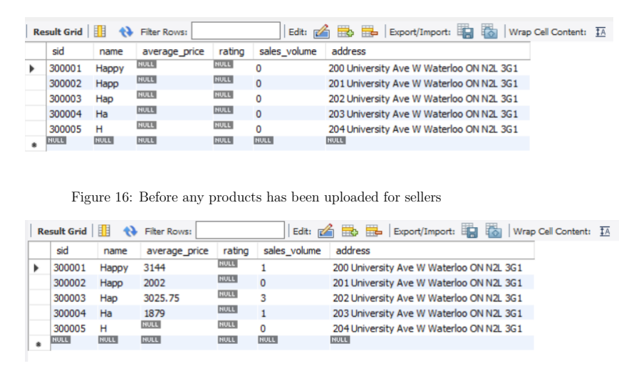

Slide 18
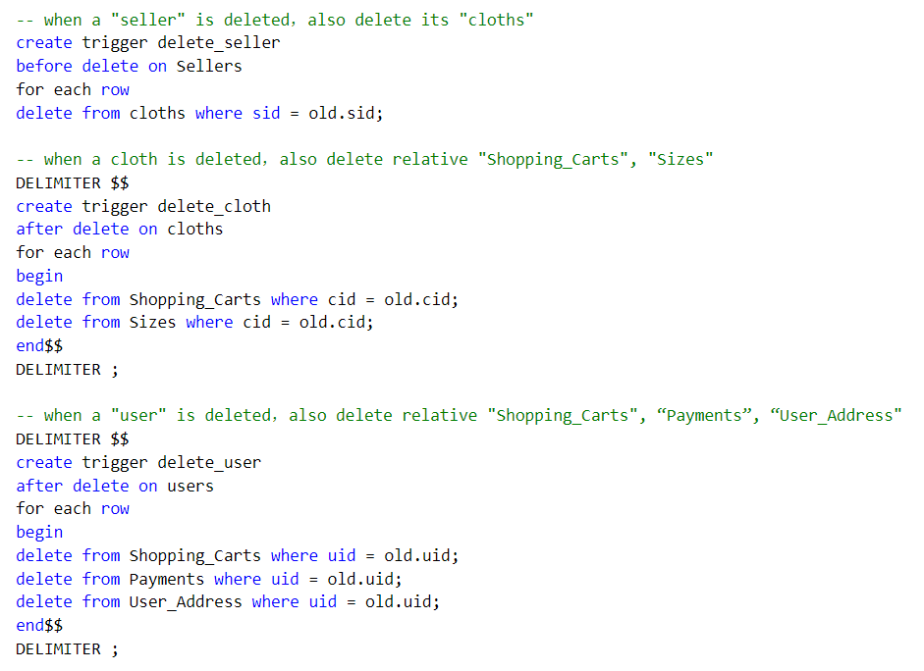
Feature 6 - to delete invalid information on time (using triggers)
ABOUT
Features
CONTRIBUTION
SUMMARY
DEMO PRESENTATION

Slide 19
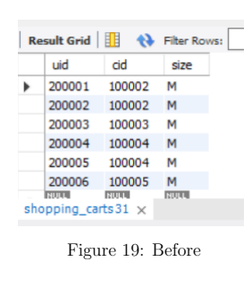
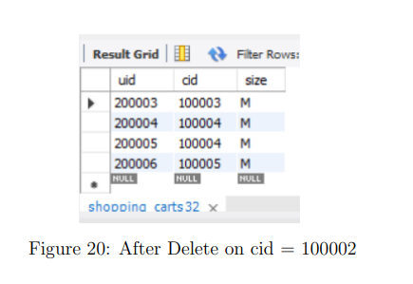

Slide 20
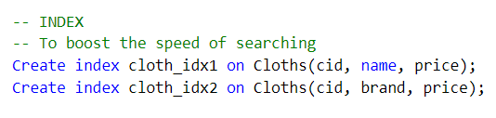
Fancy Feature 1 - use index to boost the speed of searching
ABOUT
Features
CONTRIBUTION
SUMMARY
DEMO PRESENTATION

Slide 21
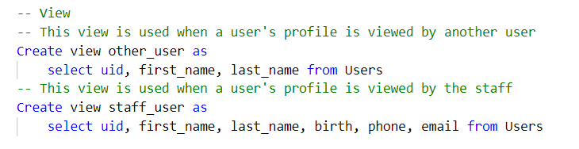
Fancy Feature 2 - use view to allow authorization
ABOUT
Features
CONTRIBUTION
SUMMARY
DEMO PRESENTATION

Slide 22
Fancy feature 3 - User-Friendly Interface
ABOUT
Features
CONTRIBUTION
SUMMARY
DEMO PRESENTATION

Slide 23
Fancy feature 4 - Verification code sent to email
ABOUT
Features
CONTRIBUTION
SUMMARY
DEMO PRESENTATION

Slide 24
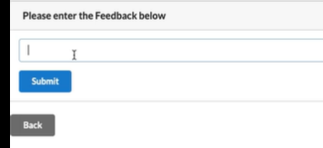
Fancy feature 5 - User Feedback
ABOUT
Features
CONTRIBUTION
SUMMARY
DEMO PRESENTATION

Slide 25

ABOUT
FEATURES
CONTRIBUTION
SUMMARY
03
Contribution
DEMO PRESENTATION

Slide 26
ABOUT
FEATURES
CONTRIBUTION
SUMMARY
Week 1
Everyone generates report for Milestone 0
Week 2-3
- brainstorm the structure
- Y+E: create sample dataset and complete MySQL dataset structure.
- C+S: complete front-end architecture and coding structure
Milestone 0
Milestone 1
Milestone 2
Generate report
Generate report
Generate report
Week 4
- C+S: front-end architecture
- Y+E: back-end code
- generates report for milestone 1
Week 1
(Sep 26-Oct 2)
Week 2-3
(Oct 3-16)
Week 4
(Oct 17-23)
Week 5-7
(Oct 24-Nov 13)
Week 8
(Nov 14-20)
Week 9-10
(Nov 21-Dec 1)
Week 5-7
- C+S: production dataset
- E+S: complicated structure (front-end)
- C+Y: database structure (trigger)
- correct the mistake for M1
Basic Structure
Complicated structure
Final Report
The structure of the web front-end and dataset
The structure of database and front-end
Project Final Demo and Report
Week 8
- complete more features
- generates report for milestone 2
Week 9-10
- fancy features
- complete feature testing
- generate final demo
- prepare for the presentation
DEMO PRESENTATION

Slide 27

ABOUT
FEATURES
CONTRIBUTION
SUMMARY
04
Summary
DEMO PRESENTATION

Slide 28
ABOUT
FEATURES
CONTRIBUTION
SUMMARY
The web application: one to infinity
React framework -> web page front-desk application
MySQL -> database support back end
The sample data and production data -> code
The basic functions: ex. uploading information, searching clothes, so on
Other efforts: the interface of the website, registration security, user feedback, freshness of dataset
What we learn from this project?
DEMO PRESENTATION

Slide 29
THANKS!
ABOUT
BUDGET
PROJECT
TIMELINE
Do you have any questions?
DEMO PRESENTATION

